Slide 1
Collection Framework
Author & Presenter -Asfiya Khan (Senior Technical Trainer)

Slide 2
Agenda
Concept of Generics
Wrapper Classes
Need of Collection
Collection Hierarchy
List
Set
Iterating Collection
Sorting In Collection
Map
Stream API – Java 8 Feature

Slide 3
Concept Of Generics
Generics in Java is similar to templates in C++.
The idea is to allow type (Integer, String, … etc and user defined types) to be a parameter to methods, classes and interfaces.
we use <> to specify parameter types in generic class creation.
Syntax :
BaseType <Type> obj = new BaseType <Type>()
Here <Type> can be replaced with only Wrapper Classes.
In Parameter type we can not use primitives like 'int','char' or 'double'

Slide 4
Concept Of Generics - Need
Code Reuse - We can write a method/class/interface once and use for any type we want.
Type Safety - Generics make errors to appear compile time than at run time (It’s always better to know problems in your code at compile time rather than making your code fail at run time)
Explicit Type Casting is not needed
Implementing generic algorithms

Slide 5
Wrapper Classes
Java provide 8 primitive data types
Sometimes there is a need to treat these primitives as objects
Therefore Java provides class counterparts for those primitive data types which are known as Object Wrappers or Wrapper classes.
Wrapper classes provide home for methods & variables related to the type.
There are certain classes which can deal only with Objects & not primitive types (here wrapper classes are useful) : e.g. Collections
Example: Integer i =new Integer(4); int x = i.intValue();
int y = Integer.parseInt(“4”);

Slide 6
Auto Boxing and Unboxing
In JDK 1.4.x:
As any Java programmer knows, you can’t put an int (or other
primitive value) into a collection.
Collections can only hold object references.
you have to box primitive values into the appropriate wrapper class (which is Integer in the case of int).
When you take the object out of the collection, you get the
Integer that you put in.
if you need an int, you must unbox the Integer using the intValue method
All of this boxing and unboxing is a pain, and clutters up your code

Slide 7
Auto Boxing and Unboxing
Before:
int i = 12;
ArrayList l = new ArayList();
l.add(new Integer(i)); …………… Explicit Boxing
Integr a= l.get(index);
int b= a.intValue(); ……………
Explicit Unboxing

Slide 8
Auto Boxing and Unboxing
Now:
The auto boxing and unboxing feature automates the process, eliminating the pain and the clutter.
Example:
int i = 12;
ArrayList l = new ArrayList();
l.add(i); …………… Auto Boxing
int a = l.get(index); ………… Auto Unboxing

Slide 9
Need of Collection
Java's collection classes provides a higher level interface than arrays.
Arrays have a fixed size. Collections have a flexible size.
Efficiently implementing a complicated data structures (e.g., hash tables) on top of raw arrays is a demanding task. The standard HashMap gives you that for free.
There are different implementation you can choose from for the same set of services: ArrayList vs. LinkedList, HashMap vs. TreeMap.

Slide 10
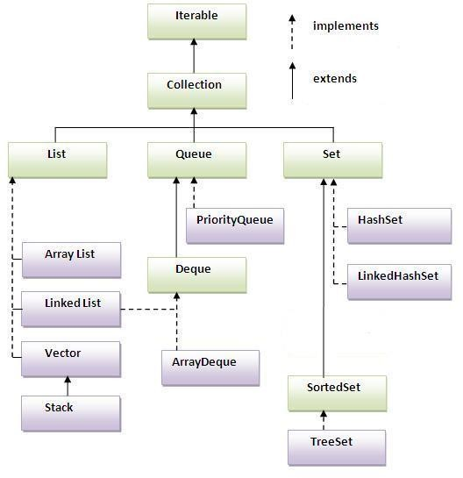
Collection Hierarchy

Slide 11
Collection Interface
Collection is an interface in the java.util package, and as its name
suggests, it is used to define a collection of objects.
Methods in Collection Interface:
boolean add (Object o)
boolean addAll (Collection c) void clear()
boolean contains ( Object o) boolean isEmpty()
Iterator iterator()
boolean remove (Object o) int size()

Slide 12
List
Its an ordered collection.
Unlike sets, lists typically allow duplicate elements
They typically allow multiple null elements if they allow null
elements at all
Example: ArrayList , LinkedList

Slide 13
List
import java.util.*;
public class ListDemo
{
public static void main (String[] args)
{
List<String> friuts = new ArrayList<String>();
friuts.add(“Mango");
friuts.add(“Apple");
friuts.add(“StrawBerry");
friuts.add(“Orange");
friuts.add(“Kiwi");
List<String> range = new ArrayList<String>();
range = friuts.subList(2, 4);
System.out.println(range);
}
}

Slide 14
Set
Set :
Its a Collection of unique elements
( i.e. a set contains no duplicate elements ) The elements are not ordered
Set can contain at most one null element Example: HashSet
Sorted Set: It’s a sub interface of Set. It further guarantees that its iterator will traverse the set in ascending element order, (sorted according to the natural ordering of its elements)
Example: TreeSet

Slide 15
Set
import java.util.*;
public class SetExample {
public static void main(String[] args) {
Set set = new HashSet();
set.add("one");
set.add("second");
set.add("3rd");
set.add(new Integer(4));
set.add(new Float(5.0F));
set.add("second"); set.add(new Integer(4));
System.out.println(set);
}
} What will be the Output ?

Slide 16
Iterating Collection – Iterator Interface
Allows the user to visit the elements of a collection one by one
It has three methods:
boolean hasNext() Object next()
void remove()
Code Example:
List list = new ArrayList();
// add some elements Iterator elements = list.iterator(); while ( elements.hasNext() ) {
System.out.println(elements.next());
}

Slide 17
Sorting In Collection
sort() method is present in java.util.Collections class which is used to sort any (Predefined Type) List in ascending order.
Example –
Let us suppose that our list contains
{“Hello", "Friends", "Dear", "Is", "Superb"}
After using Collection.sort(), we obtain a sorted list as
{"Dear", "Friends", “Hello", "Is", "Superb"}
For applying sort method on User Defined Types Collection we require to implement
Comparable or Comparator interface.

Slide 18
Comparable Vs Comparator
Comparable lets a class implement its own comparison
It's in the same class (it is often an advantage)
There can be only one implementation (so you can't use that if you want two different sorting cases)
Comparator is an external comparison
It is typically in a unique instance (either in the same class or in another place)
You name each implementation with the way you want to sort things.
You can provide comparators for classes that you do not control.

Slide 19
Comparable Vs Comparator
To implement Comparable interface, class must implement a single method compareTo()
public int compareTo(Object o){}
To implement Comparator interface, class must implement a single method compare()
public int compare (Object obj1 , Object obj2){}

Slide 20
Map
Map
An object that maps keys to values.
A map cannot contain duplicate keys
Each key can map to at most one value.
The Map interface provides three collection views,
which allow a map's contents to be viewed as:
a set of keys
a collection of values
a set of key-value mappings
SortedMap
TreeMap
HashMap
•
Examples : HashMap,TreeMap

Slide 21
Map Demo
Class MapDemo{
p.s.v.main(String args[]){
HashMap hm=new HashMap();
hm.put("Let us c",300);
hm.put("Let us c++",400);
hm.put("Thinking in Java",350);
Iterator itr=hm.entrySet().iterator(); while(itr.hasNext())
{
System.out.println(itr.next());
}
}
} Output Generated: Let us c=300 Thinking in Java=350 Let us c++=400

Slide 22
Stream API – Java 8 Feature
The Stream API is used to process collections of objects.
A stream is a sequence of objects that supports various methods which can be pipelined to produce the desired result.
Each intermediate operation is lazily executed and returns a stream as a result, hence various intermediate operations can be pipelined.
Following are the different operations On Streams-
Intermediate Operations: Terminal Operations:
map collect
filter forEach
sorted reduce

Slide 23
Stream API – Java 8 Feature
map :
List number = Arrays.asList(2,3,4,5); List square = number.stream().map(x->x*x).collect(Collectors.toList());
filter :
List names = Arrays.asList("Reflection","Collection","Stream"); List result = names.stream().filter(s->s.startsWith("S")).collect(Collectors.toList());
sorted:
List names = Arrays.asList("Reflection","Collection","Stream"); List result = names.stream().sorted().collect(Collectors.toList());

Slide 24
Stream API – Java 8 Feature
collect:
List number = Arrays.asList(2,3,4,5,3); Set square = number.stream().map(x->x*x).collect(Collectors.toSet());
forEach:
List number = Arrays.asList(2,3,4,5); number.stream().map(x->x*x).forEach(y->System.out.println(y));
reduce:
List number = Arrays.asList(2,3,4,5); int even = number.stream().filter(x->x%2==0).reduce(0,(ans,i)-> ans+i);

Slide 25


Slide 26


Thank You!
9/4/2019
www.cybage.com
Copyright © 2019 Cybage Software Pvt. Ltd. All Rights Reserved. Cybage Confidential.

